Slide 1
Residential Fire Sprinklers in the
2010 CA Codes
November 15, 2011

Slide 2
Why Sprinklers in Dwellings?
NFPA Report in 2005
“Fire Loss in the United States During 2005”:
  25% of structure fires occurred in residential structures
  83% of fire deaths in residential structures
  77% of fire injuries in residential structures

Slide 3
Why Sprinklers in Dwellings?
NFPA Report in 2007
  “Fire Loss in the United States 2007”:
  78% of all structure fires occurred in residential structures
  3,430 civilian fire deaths, 84% (2877) of which occurred in dwellings
  Nationwide there was a civilian fire death every 183 minutes

Slide 4
Why Sprinklers in Dwellings?
NIST reports:
  In 1975 occupants had 17 minutes to safely escape a dwelling fire
  In 2003 occupants had only 3 minutes to safely escape a dwelling fire
  In 2007 the chance of death in a dwelling fire is reduced 82% with fire sprinklers and smoke alarm
  Over 2,000 fires were reported from 2000 to 2005 in dwellings WITH fire sprinklers
    There were NO fatalities in any of the fires with sprinklers
Notes:
Residential fire sprinklers are highly effective in saving lives fires
Residential fire sprinklers look like fire sprinklers found in non-residential buildings, but they are quite different
Residential fire sprinklers are designed to stop fires using smaller water supplies
Residential fire sprinklers are a highly effective yet very affordable means of protecting men, women and children from death and injury

Slide 5
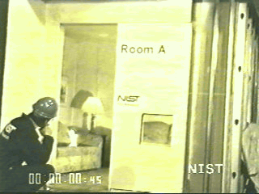
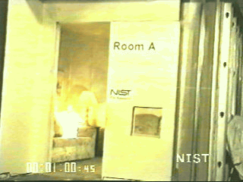
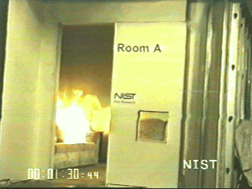
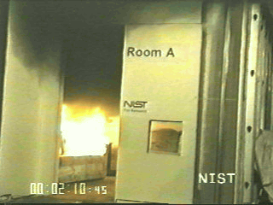
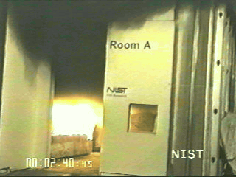
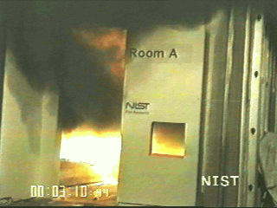
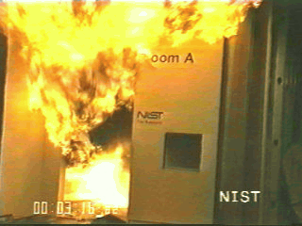
NIST Dwelling Fire Test
Without Fire Sprinklers
Flashover
occurred
Notes:
Note the time clock in the lower left hand corner of each picture.

Slide 6
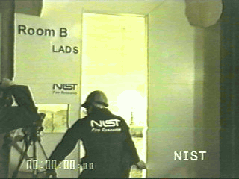
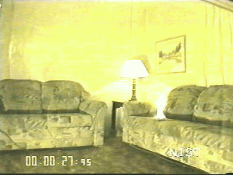
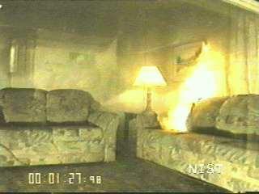
NIST Dwelling Fire Test
With Fire Sprinklers
Sprinkler
operated
Notes:
Note the time clock in the lower left hand corner of each picture.

Slide 7
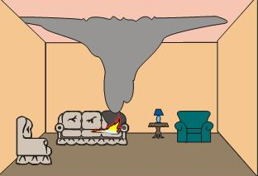
Testing for Tenability
Ceiling temp <600ºF
Breathing level <200ºF
Oxygen >16%
CO <3000 ppm
Tenability - 10 minutes with 2 sprinklers

Slide 8
Life Safety System
Residential Fire Sprinklers are designed to protect the occupants
RFS system is simplified
Reliability and dependability
  Components for property protection are not included
  Components needing maintenance are not included
  Maintenance?

Slide 9
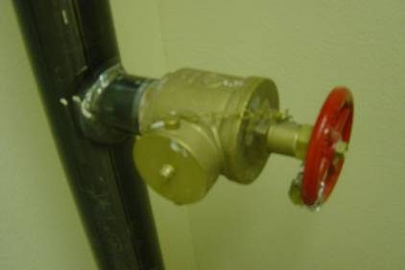
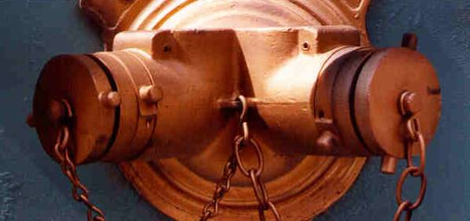
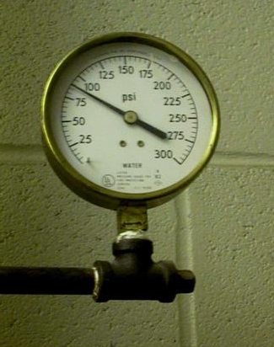
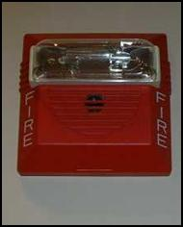
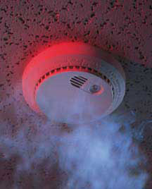
Commercial Fire Sprinkler
System Components
Fire hose water supply (Hose stream allowance)
FDC
Water Flow Alarm or Gauge on riser
Smoke alarm is only alarm

Slide 10
2010 CRC Requirements
2009 Edition of the International Residential Code (IRC) with California Amendments
2010 California Residential Code
California Code of Regulations
Title 24, Part 2.5

Slide 11
2010 CRC Requirements
R313.1 Townhouse automatic fire sprinkler systems. An automatic residential fire sprinkler system shall be installed in townhouses.
  Exception: An automatic residential fire sprinkler system shall not be required when additions or alterations are made to existing townhouses that do not have an automatic residential fire sprinkler system installed.

Slide 12
2010 CRC Requirements
R313.2 One- and two-family dwellings automatic fire sprinkler systems. An automatic residential fire sprinkler system shall be installed in one- and two-family dwellings.
  Exception: An automatic residential fire sprinkler system shall not be required for additions or alterations to existing buildings that are not already provided with an automatic residential sprinkler system.

Slide 13
Design Standards
R313.1.1 Design and installation. Automatic residential fire sprinkler systems for townhouses shall be designed and installed in accordance with Section R313.3 or NFPA 13D.
R313.2.1 Design and Installation. Residential fire sprinkler systems shall be designed and installed in accordance with Section R313.3 or NFPA 13D.

Slide 14
Design Standards
R313.3.1 General. Where installed, residential fire sprinkler systems, or portions thereof, shall be in accordance with NFPA 13D or Section R313.3, which shall be considered equivalent to NFPA 13D. Section R313.3 shall apply to stand-alone and multipurpose wet-pipe sprinkler systems that do not include the use of antifreeze. A multipurpose fire sprinkler system shall supply domestic water to both fire sprinklers and plumbing fixtures. A stand-alone sprinkler system shall be separate and independent from the water distribution system. A backflow flow preventer shall not be required to separate a stand-alone sprinkler system from the water distribution system.

Slide 15
State Statutory Authority from CA SFM Website
Question: Can a Fire Protection Contractor (C-16) design the system that he or she is to install?
Answer:
  YES
  B&P Code – Contractors License Law 6737.3
Question: What does CRC say regarding the design and installation of residential fire sprinkler systems?
Answer:
  See CRC §R313.1.1
  R313.1.1 Design and installation. Automatic residential fire sprinkler systems for townhouses shall be designed and installed in accordance with R313.3 or NFPA 13D.

Slide 16
State Statutory Authority from CA SFM Website
Question: Is it the intent of CRC §R313 to allow residential fire protection systems to be installed by a Fire Protection Contractor (C-16) and/or a Plumbing Contractor (C-36)?
Answer:
  Only Fire Protection Contractors (C-16’s), General Manufactured Housing Contractors (C-47’s) and Owner-Occupied Owner-Builders may install a fire protection system.
  B&P Code – Contractors License Law, Sections 7026.2(a), 7026.3, 7026.11, 7026.12
  B&P Code 7008, 7058, and 7059
  CSLB Regs 832.47 – Class C-47 – General Manufactured Housing Contractor

Slide 17
Fire Sprinkler Installation
Sprinklers installed in all areas of the dwelling unit
Excluded areas:
  Attics, crawl spaces and normally unoccupied concealed spaces, unless these spaces contain a fuel-fired appliance
  Clothes closets, linen closets and pantries where:
    Wall and ceiling surfaces are of gypsum board, and
    The space <24 ft² and
    The smallest dimension <3’

Slide 18
Fire Sprinkler Installation
Sprinklers installed in all areas of the dwelling unit
Excluded areas:
  Bathrooms <55 ft²
  Unheated entry areas, such as mud rooms, that are adjacent to an exterior door and similar areas
  Detached garages
  Carports without habitable space above
  Open attached porches
Different than NFPA 13D

Slide 19
CRC Requirements vs NFPA 13D
CRC §R313.3.5 requires the inclusion of 5 gpm for domestic flow
  Domestic shutoff valves can eliminate this flow
CRC §R313.3.1.1 requires attached garages to be protected with fire sprinklers
  Design criteria included in CBC/CFC §903.2.18

Slide 20
Dwelling Floor Plan
Sprinklers required in:
  Living areas
  Attached garage

Slide 21
Attached Garage Sprinklers
Residential sprinklers or quick-response sprinklers
Provide a minimum density of 0.05 gpm/ft²
Garage doors shall not be considered obstructions with respect to sprinkler placement

Slide 22
Questions???

