Slide 1
Residential Fire Sprinkler Concerns

Slide 2

Water Supplier Reliability Issues
Water Supply
Water Facilities
Water Quality
Cost

Slide 3
General Policy Issues
Balancing Competing Interests
Service
  Reliability
  Flexibility
  Quality
Cost
  “Home Rule”
  Affordable
  Universal
Liability
  Supply
  Operational

Slide 4

Service
Reliability
  24/7 x 150 years

Slide 5

Cost
Home Rule - California has it all
  Private
    Individual
    Corporation
  Municipal
  Special District / Agency
  All agency’s issues include political considerations

Slide 6

Liability
Supply Reliability -
  Need to build redundancy and reliability
Operational Risk
  Issues with maintaining pressurized water pipe and appurtenances

Slide 7
Cost
Affordability
  Essential service – public health - economic development – recreation - and public fire supply
Universal
  Responsibility to serve equitably without administrative burden

Slide 8
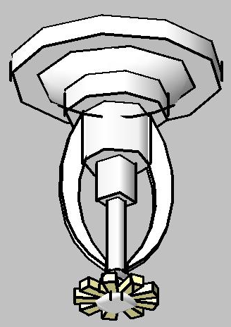
Discussion
Background
Meter Sizing Study
Recommendations
Examples/Configuration
Cost
Notes:
Background – What WRK talked about in previous forum, Task Force, code change
Meter Sizing Study – research, hydraulics, surveys, cost

Slide 9
Background
SFM Task Force
  Phase I – Water Supply
  Phase II – Installation
  Phase III – Training and Education
Retrofitting
Meter sizing
Notes:
2008-2009, The Fire Sprinkler/Water Purveyor Task Force (Task Force) included representatives from the fire agency, water agency, building industry, and fire sprinkler design industry.
All phases are complete, Water Supply Issues (Phase I), Installation Issues (Phase II), and Training and Education Issues (Phase III – many trainings conducted by SFM).

Slide 10
Background
2010 CRC, Section R313.1-5
NFPA-13D
Domestic allowance
Current practice vs. new code
Notes:
2010 California Residential Code requires all new one- and two-family homes (R313.2) and townhouses (R313.1) to install fire sprinklers, supply systems should be sized for the sprinkler demand plus 5 gpm domestic allowance (NFPA 13D and as of this year R313.5).

Slide 11
Determining Meter Size
Current Practice
Fire Flow plus Total Peak Domestic Flow
New Code
Fire Flow plus 5 gpm Domestic Allowance
82 gpm | (FF = 4 heads @ 20.5 pm)
+ 20 gpm | (Peak Domestic)
102 gpm | → 2” meter
82 gpm | (FF = 4 heads @ 20.5 gpm)
+ 5 gpm | (Domestic Allowance)
87 gpm | → 1.5” meter
Notes:
Current practice vs new code
Previously the code did not specify a domestic allowance for combination fire and domestic meter sizing, so to ensure adequate flow EBMUD sized meters based on the sum of the FF requirement and the peak domestic demand (all fixtures running), leading to a higher design flow than the new code suggests.
Example from the real world, an application that came in this summer:
EBMUD’s current practice:
Fireflow (82) + Peak Domestic Flow based on FU (20) → 2” meter (102)
New Code:
Fireflow (82) + 5 gpm → 1.5” meter (87)

Slide 12
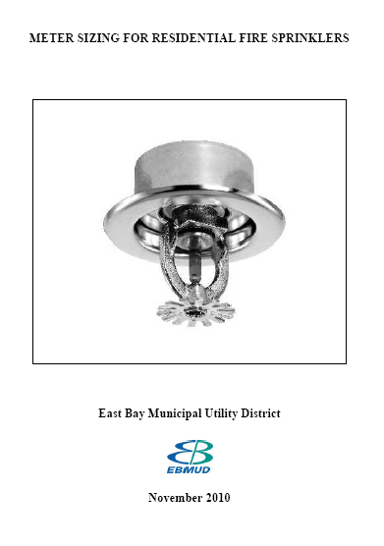
EBMUD Meter Sizing Study
Research
Hydraulics
Surveys
Cost
Notes:
We completed a study on Meter Sizing for Residential Fire Sprinkler:
-Researched demands and the domestic allowance,
-Evaluated hydraulics through the service lateral and meter,
-Surveyed other agencies on their sizing practices,
-Cost implications of our recommendation.
Email everyone on the sign in sheet a copy of the report.

Slide 13
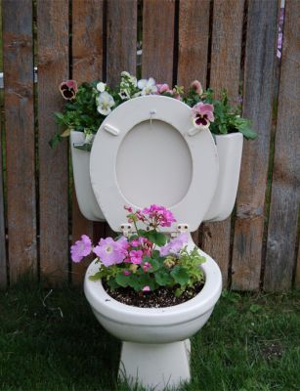
Research – Domestic Allowance
Toilet – 4 gpm
Sink – 2 gpm
Shower – 3 gpm
Washing machine – 4 gpm
Dishwasher – 3 gpm
Irrigation – 10-15 gpm
Notes:
List of typical household fixtures and flows
We tried to figure out where the code’s 5 gpm allowance came from (NFPA docs, Task Force, industry leaders)…in the end, there was no answer.
Instead, we wanted to at least make sure it was a reasonable number.
Most of these fixtures/appliances are within 5 gpm, if running alone, and their peak flows are temporary, shorter than the duration of a fire event.
Exception – irrigation! Larger flow, longer duration

Slide 14
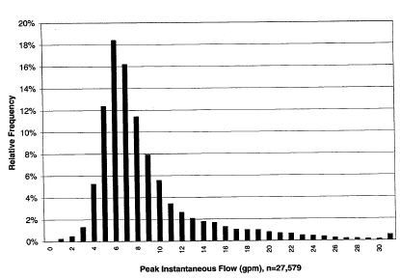
Research – Domestic Allowance
Only 20% of flows ≤ 5 gpm
90% of flows ≤ 15 gpm
American Water Works Association Research Foundation sponsored study:
Residential End Uses of Water, Report No. 90781, 1999
Notes:
AWWARF
Peak instantaneous flows from over 27,000 data points 1,188 homes, 12 study sites and the percentage of occurrences of those peaks.
20% of peak flows less than 5 gpm
90% of peak flows less than 15 gpm
EBMUD found this study to be representative of urban water use, and since 5 gpm only covered 20% of the peak flows, again, we wanted to research further.

Slide 15
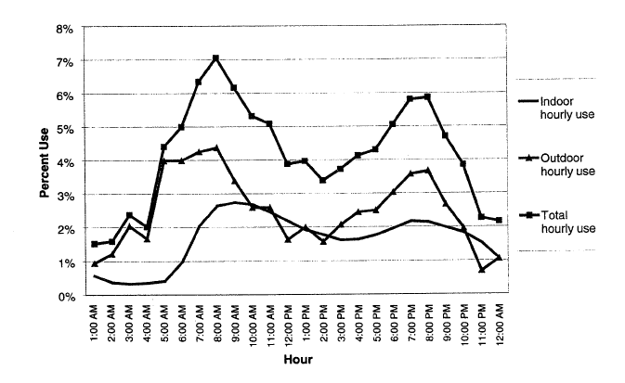
Research – Domestic Allowance
American Water Works Association Research Foundation sponsored study:
Residential End Uses of Water, Report No. 90781, 1999
Notes:
AWWARF (now WRF)
Daily demand distribution, notice peaks in both indoor and outdoor (irrigation) demand coincide with the times most fires were recorded in the 2010 Home Structures Fire report by NFPA.

Slide 16
Hydraulics - Meter Size Based on Flow
Number of Sprinkler Heads | Flow per Sprinkler Head (gpm) | Total Sprinkler Flow (gpm) | Domestic Demand (gpm) | Total Flow (gpm) | Required Meter Size (inch)
2 | 13 | 26 | 5 | 31 | 1
2 | 13 | 26 | 15 | 41 | 1
2 | 17 | 34 | 5 | 39 | 1
2 | 17 | 34 | 15 | 49 | 1
2 | 20 | 40 | 5 | 45 | 1
2 | 20 | 40 | 15 | 55 | 1.5
4 | 13 | 52 | 5 | 57 | 1.5
4 | 13 | 52 | 15 | 67 | 1.5
4 | 17 | 68 | 5 | 73 | 1.5
4 | 17 | 68 | 15 | 83 | 1.5
4 | 20 | 80 | 5 | 85 | 1.5
4 | 20 | 80 | 15 | 95 | 1.5
Maximum flow though 1-inch meter = 50 gpm
Maximum flow through 1.5-inch meter = 100 gpm
Notes:
Looking at various fire flow requirements, and both a 5 and 15 gpm domestic allowance
¾” meter capacity is 30 gpm, so with 2 heads at 26 gpm + 5 gpm domestic, already at 31 gpm, 1-inch minimum required.
Generally, the fire flow requirement will determine meter size, but not always.
2-head system will usually require 1-inch meter
4-head system will require 1.5-inch meter

Slide 17
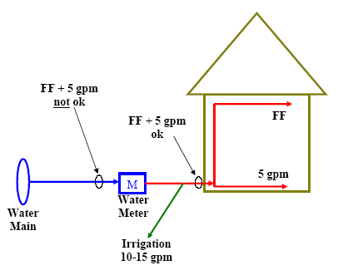
Why 15 gpm?
No study/data to support 5 gpm
5 gpm too low from water main to meter
Code language
Typical fixture flows
Irrigation
Human Reaction
Peak Instantaneous Flow
Estimate ~70%→1-inch meter & 30% → 1.5-inch meter, regardless of 5 gpm vs. 15 gpm
Notes:
No support of 5 gpm – SFM Task Force, NFPA, leading industry professionals
Fixture flows –for an irrigation configuration that looks like this - 5 may be reasonable in the house, but not enough for irrigation too
Irrigation – AWWARF study shows irrigation demand peaks in the morning and evening, coinciding with the time most residential fires occur (NFPA March 2010 Home Structure Fires), must consider irrigation and fire demand could be simultaneous.
Human Reaction – in a fire situation, it’s reasonable to assume a person would turn off a sink or a shower, and a toilet would shut itself off after a few moments. Irrigation could remain in service for 10s of minutes, or even hours, through the duration of the fire event.
Peak instantaneous Flow – AWWARF study does not indicate 5 gpm allowance is a sufficient allowance for most of the time, to the contrary, it is sufficient 20 % of the time. 15 gpm allowance would include 90 of peak instantaneous flows.
Code language – when suggesting 5 gpm, no indication that the building code is referring to water supply piping as being before the meter, water supply piping is taken to be the supply to the house.
70% - Statistically at EBMUD, about 70% of the time applicants will fall within the 50 gpm capacity of then 1-inch meter, regardless of 5 gpm or 15 gpm domestic allowance applied. For the other 30% who need a 1.5-inch meter, that’s what’s required already today, so there wouldn’t be a change.

Slide 18
Hydraulics - Headloss
Assuming flow of 31 gpm (2 heads at 13 gpm + 5 gpm domestic) | 1-inch lateral and meter | 1.5-inch lateral and meter | 2-inch lateral and meter | 1.5-inch lateral and 1-inch meter
Calculated Pressure Loss (psi) Through 30' Service Lateral (Hazen Williams) | 16.8 | 2.8 | 0.8 | 2.8
Estimated Pressure Loss Through Meter (psi) | 2.9 | 1.0 | 0.5 | 2.9
Total Pressure Loss (psi) Through Service Lateral and Meter | 19.7 | 3.8 | 1.3 | 5.7
Meter capacity (gpm) | 50 | 100 | 160 | 50

Slide 19
Hydraulics - Headloss
Assuming flow of 41 gpm (2 heads at 13 gpm + 15 gpm domestic) | 1-inch lateral and meter | 1.5-inch lateral and meter | 2-inch lateral and meter | 1.5-inch lateral and 1-inch meter
Calculated Pressure Loss (psi) Through 30' Service Lateral (Hazen Williams) | 28.2 | 4.8 | 1.4 | 4.8
Estimated Pressure Loss Through Meter (psi) | 4.8 | 1.5 | 0.7 | 4.8
Total Pressure Loss (psi) Through Service Lateral and Meter | 33.1 | 6.3 | 2.0 | 9.6
Meter capacity (gpm) | 50 | 100 | 160 | 50
Notes:
We calculated pressure losses in different size service laterals and meters, notice most of the losses are through the lateral.
Column 1 - The 1-inch lateral/meter configuration has a 33.1 psi drop just from the main to the customer side of the meter. For customers with 100 psi at the street, that’s likely fine, but for customers starting out with 30 psi, this flow would render the sprinkler system useless
Standardization - EBMUD has 132 pressure zones, we can’t determine meter size on an individual basis, we need one service configuration that works for all, including customers at the high end of the zone. Other water companies with flatter service areas and steady 80 psi throughout the system might be able to size services differently, they have head to burn. EBMUD doesn’t, so this is how we have to do it.
Column 2 - Existing practice, much lower pressure loss across the lateral, but can we optimize?
Column 3 - Great, but too big, high customer installation/monthly cost, loss on meter accuracy
Column 4 - Pressure loss is in acceptable range,
Our existing practice works (column 2), we have 4,000 customers with these services, and we will continue installing them when demands require.
But the 1.5/1 will also work, and for most typical applicants, 70%.
Minimizing size minimizes cost.

Slide 20
Pressure Loss through Backflow Preventers
Backflow Device |  | Pressure Loss at Given Flow (psi)
1-inch |  | 26 gpm | 31 gpm | 34 gpm | 41 gpm
Double Check¹ |  | 5.6 | 6.0 | 6.5 | 7.4
Reduced pressure² |  | 12.0 | 12.3 | 12.3 | 13.1
1.5-inch
Double Check³ |  | 4.7 | 4.7 | 4.7 | 5.0
Reduced Pressure⁴ |  | 11.5 | 11.5 | 11.5 | 11.5
Data is from manufacturers' specifications sheets
1. Average of headlosses from 6 Febco, Watts, and Wilkins 1-inch double check valves. 2. Average of headlosses from 11 Febco, Watts, and Wilkins 1.5-inch reduced pressure valves. 3. Average of headlosses from 5 Febco, Watts, and Wilkins 1-inch double check valves. 4. Average of headlosses from 10 Febco, Watts, and Wilkins 1.5-inch reduced pressure valves.

Slide 21
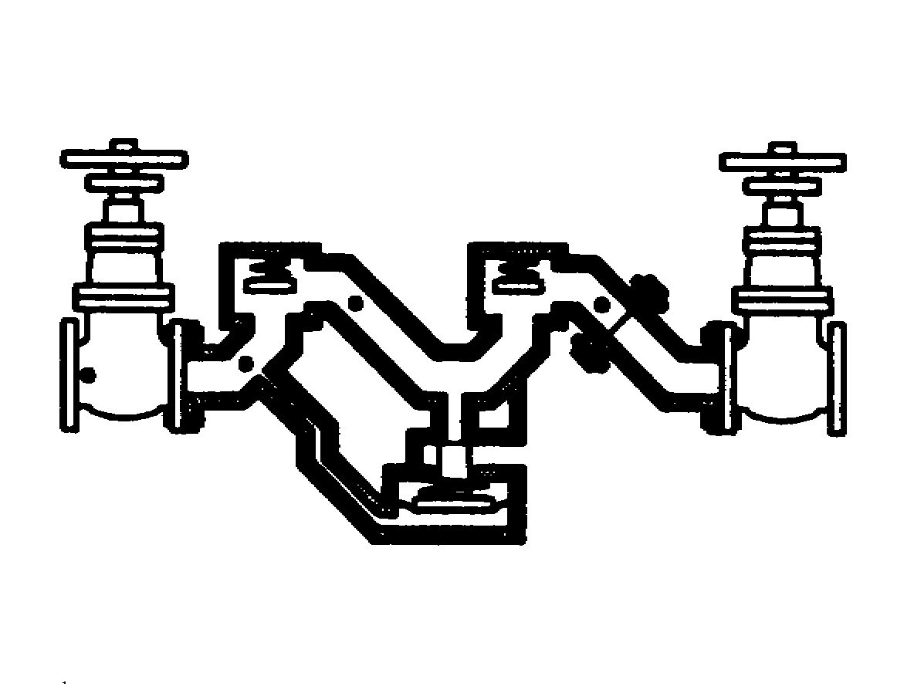
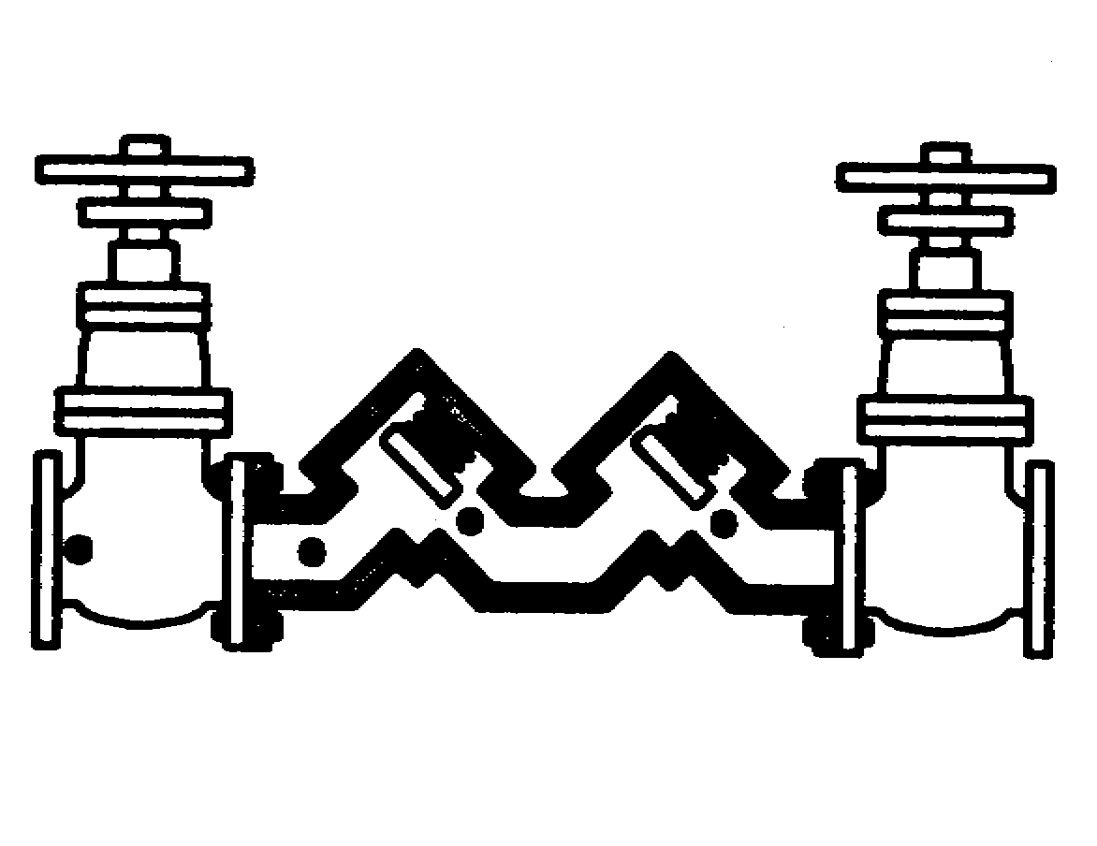
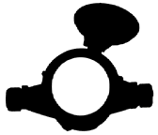
EBMUD’s Backflow Preventer Requirements
 | Backflow Preventer Type
Property Description | Double Check | Combo Meter | Reduced Pressure
Well located on property, not cross-connected | ✓
Well located on property, not cross-connected, installation area restrictions do not allow double check valve |  | ✓
Well located on property is cross-connected |  |  | ✓
Notes:
A DC is a mechanical backflow preventer that consists of two independently acting, spring-loaded check valves. It includes shutoff valves at each end of the assembly and is equipped with test cocks. A DC is effective against backpressure backflow and back siphons but should be used to isolate only non-health hazards. – MAY BE INSTALLED BELOW GRADE
An RP is a mechanical backflow preventer that consists of two independently acting, spring-loaded check valves with a hydraulically operating, mechanically independent, spring-loaded pressure differential relief valve between the check valves and below the first check valve. It includes shutoff valves at each end of the assembly and is equipped with test cocks. An RP is effective against backpressure backflow and back siphonage and may be used to isolate either health or non- health hazards. – MUST BE INSTALLED 12” ABOVE GRADE

Slide 22
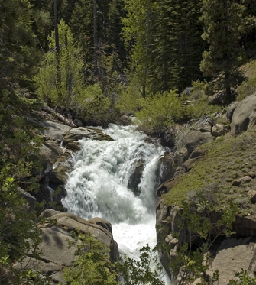
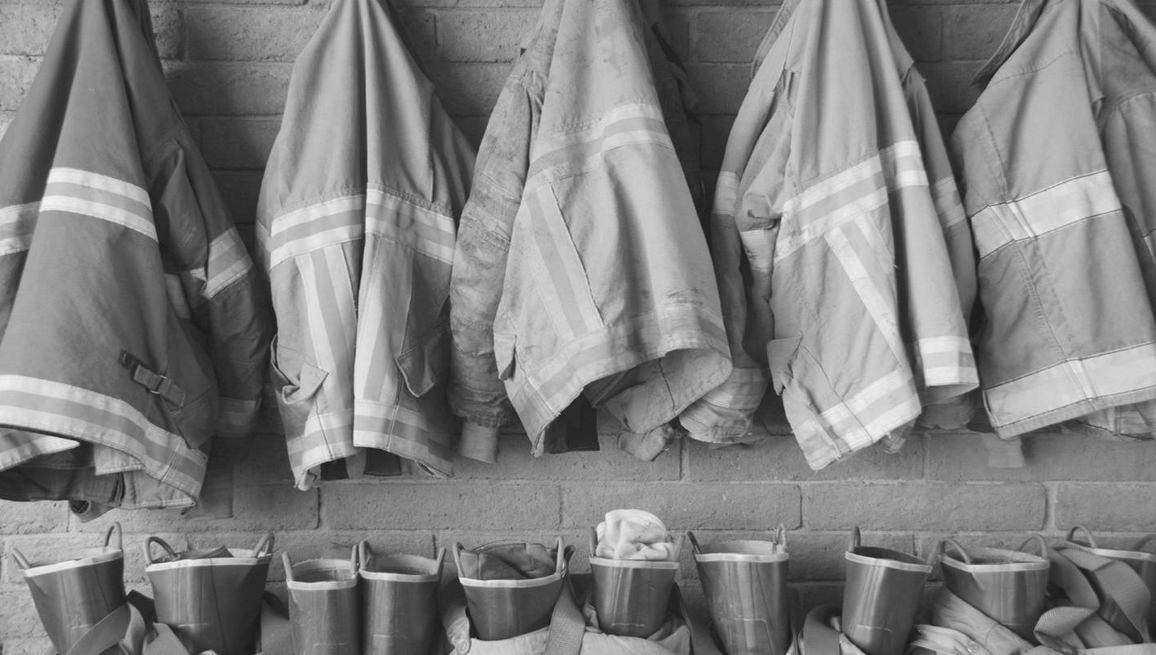
Surveys
Water purveyors – typical meter size
Fire departments – typical sprinkler flow requirement
Notes:
We surveyed other agencies to see how they are sizing their meters
Of the 11 water agencies contacted, 10 use 1-inch meter when sprinklers are required, SC installs separate 2-inch service for fire protection,
Fire – Alameda/Contra Costa/San Ramon all said the typical fire sprinkler flow requirement is 2 heads @ 13 gpm,
Recognize certain factors can change these requirements,
Now we’re seeing varied flow requirements, and even 4 head counts.

Slide 23
Water Shut-off Risk
What is fire probability given statistical opportunity??
Probability off = # houses off / total #_{(EBMUD)}
= ~5%
Probability fire = Chance is < 1 in 300 per year_{(NFPA)}
= 0.33%
Probability = Po x Pf
  = 0.0165%
Notes:
Assumes same internal causal liabilities, namely cooking and heating and smoking and the like. Problematic if the house is truly
Vacant so real risk may actually be much lower --- approaching zero.

Slide 24
Water Shut-off
Cost vs. Risk
Cost of two service configuration, no shut-off
Additional service lateral (unpaved) and BFP ~ $1,700
Monthly cost would increase + $12.60/mo. @ EBMUD
Ten year PW = $12.60x12_{mo}x10_{yr}
  = $1,512
PW10 ~ $3,200
PW60 ~ $19,000 ^{> for a near zero risk}

Slide 25
1-inch Meter Examples
1.5-inch tap and lateral
1-inch meter
Examples
26 gpm | (FF = 2 heads @ 13 gpm)
+ 15 gpm | (Domestic Allowance)
41 gpm | → 1” meter
35 gpm | (FF = 2 heads @ 17.5 gpm)
+ 15 gpm | (Domestic Allowance)
50 gpm | → 1” meter
Notes:
The 1.5” lateral and 1” meter configuration will accommodate the 2 head sprinkler requirement across a range of typical fire flow requirements

Slide 26
1.5-inch Meter Examples
1.5-inch tap and lateral
1.5-inch meter
Examples (note same meter for 5 gpm)
52 gpm | (FF = 4 heads @ 13 gpm)
+ 15 gpm | (Domestic Allowance)
67 gpm | → 1.5” meter
68 gpm | (FF = 4 heads @ 17 gpm)
+ 15 gpm | (Domestic Allowance)
83 gpm | → 1.5” meter
Notes:
The 1.5”/1.5” configuration will accommodate the 4-head requirement across a range of typical fire flow requirements.

Slide 27
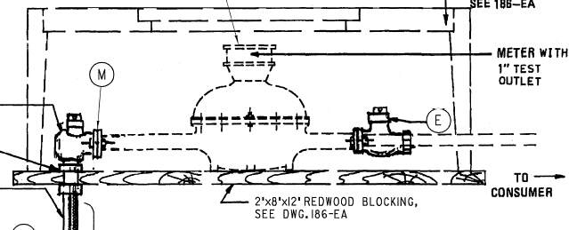
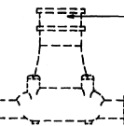
Final Configuration
Minimum 1.5-inch lateral with 1-inch meter for flows ≤ 50 gpm
1.5” x 1”
reducer
1”
1.5”
Size based on FF + 15 gpm or the Total Peak Domestic Demand, whichever is greater
Notes:
Recommendations
Minimum/configuration is a hybrid – 1.5-inch service lateral and 1-inch meter with additional 1.5”x1” reducer from lateral to meter – will work for ~70% of applicants.
Meter size determined by fire flow plus 15 gpm domestic allowance, or the peak domestic flow based on fixture unit counts, whichever is higher.
example: large mansion with high day to day demand, but layout of home requires only a two head system. If Peak domestic flow is 52 gpm, and FF + domestic allowance is 26+15 = 41 gpm, we will size for the 52 gpm, a 1.5-inch meter.

Slide 28
EBMUD Combination Meter Sizing
State code requires fire flow plus 5 gpm for simultaneous domestic flow
Meter Study found fire flow +15 gpm
  Staff studied SFR daily peak flow: Over 90% of recorded SFR peak flow were 15 gpm or less
  1" meter with 1.5" tap/lateral up to 50 gpm flow (typical 2 sprinkler head systems)
  A lower system requirement than past @ EBMUD
  No change in Backflow requirements – need to be mindful of low service pressures

Slide 29
Special Case Reviews
1-inch lateral installed, no meter set
Total flow just over 50 gpm
Total flow just over 100 gpm
Solutions?: Check pressures, reduce Sprinkler FF, or add domestic SO valve
Notes:
– existing services with no meters installed will be handled under existing regulations and dealt with on a case by case basis.
sunset clause allows one year after T&L are installed to have meter set, else new application required,
additional review fee if customer thinks 1-inch lateral is sufficient, customers duty to show what they need, will only work in high pressure areas
- If flow comes out to 52 gpm, or 102 gpm
customer can request fire department reduce the sprinkler requirement, we will work with the customer and FD on potential meter size reduction
or install a domestic shutoff valve and only need capacity for greater of domestic or fire requirement.

Slide 30
Cost
No changes to EBMUD’s Schedule of Rates and Charges
Installation = $106 less for new configuration
One-inch meter = $14.05 reduction in monthly charge from 1.5-inch meter

Slide 31
FY12 Monthly Meter Service Charges
Meter Size | Monthly Meter Charge (including Seismic)
1.5-inch Meter (current standard SFR combination meter size) | $35.32
1-inch Meter (proposed standard SFR combination meter size) | $21.27
5/8- or 3/4-inch Meter (most SFR without fire sprinklers) | $12.60

Slide 32
A Water Purveyors Perspective
Thank you for this opportunity
Any questions?

